Slide 1
MEDIWISE A Healthcare Chatbot using NLP
Batch ID: B028
Aniket Mishra (RA2011003010098)
Nandini Nigam(RA2011003010124)
Under the guidance of - Dr. T.K Sivakumar
(Assistant Professor Senior Grade, CTECH)

Slide 2
Abstract
This project aims to develop an innovative and intelligent
conversational agent to enhance healthcare services and improve
patient experiences.
It is designed to provide a wide range of healthcare-related
services, including appointment scheduling, symptom assessment,
medication reminders, health education, and general medical
inquiries.
Through its intuitive interface and empathetic conversational style,
the chatbot aims to bridge the gap between patients and healthcare
providers, promoting efficient communication and reducing the
burden on medical staff.
The success of the Healthcare Chatbot project will be assessed
through user feedback, system performance evaluations, and
comparison with existing healthcare support systems. This project
aims to provide a scalable, accessible, and user-friendly solution
that can be integrated into existing healthcare platforms and mobile
applications, contributing to the overall improvement of healthcare
delivery and patient outcomes.

Slide 3
Introduction
In the rapidly evolving landscape of healthcare, technology has
emerged as a transformative force, reshaping how medical
services are delivered and experienced. Mediwise stands at the
intersection of this transformation, aiming to harness the power
of cutting-edge artificial intelligence and natural language
processing to revolutionize patient interactions and healthcare
delivery.
With the ubiquity of digital communication and the increasing
demand for personalized healthcare solutions, the development
of an intelligent conversational agent holds immense potential
to bridge gaps, enhance patient engagement, and streamline
medical processes.
This project embarks on a journey to create a state-of-the-art
Healthcare Chatbot that not only offers a spectrum of tailored
services but also empowers patients to navigate their healthcare
journeys with informed decisions. By leveraging technology’s
prowess, this endeavor aspires to cultivate a more patient-
centric, efficient, and responsive healthcare ecosystem.

Slide 4
Distinguishing Factors
Conversational Empathy
1
Comprehensive Healthcare Services
2
Diverse Data Integration
3
Advanced Tech Enhancement
4
User-Centric Design
5

Slide 5
Problem Statement
This project creates a healthcare chatbot using AI and language technology to enhance patient experiences. Named "Mediwise," it connects patients and healthcare providers, aiding tasks like scheduling, symptom assessment, medication reminders, and medical queries. The chatbot aims to empower patients, improve communication, and advance healthcare technology with NLP algorithms and data insights. The goal is efficient, patient-centric care, revolutionizing healthcare delivery for improved outcomes and seamless tech integration.

Slide 6
Objective
This project aims to use AI and natural language processing to create a smart conversational agent that overcomes limitations in traditional patient-provider communication. By offering personalized and immediate assistance, individuals can access medical information, schedule appointments, manage medications, and understand health conditions. This technology bridges gaps between patients and healthcare providers, leading to better outcomes and a more efficient healthcare system. Additionally, it lightens the load on medical staff, allowing for improved resource allocation and focused patient care. The goal is to modernize healthcare, empower patients, and contribute to better well-being for everyone.

Slide 7
Proposed System
The Healthcare Chatbot project introduces a revolutionary conversational agent with innovations including:
1. Advanced NLU: Understands context for precise responses.
2. Emotionally Aware: Responds empathetically, adapting to users' emotions.
3. Dynamic Learning: Improves over time with continuous learning.
4. Comprehensive Services: Offers various healthcare services.
5. Integration: Seamlessly fits into existing healthcare platforms.
6. Real-time Analytics: Provides insights into patient needs and trends.

Slide 8
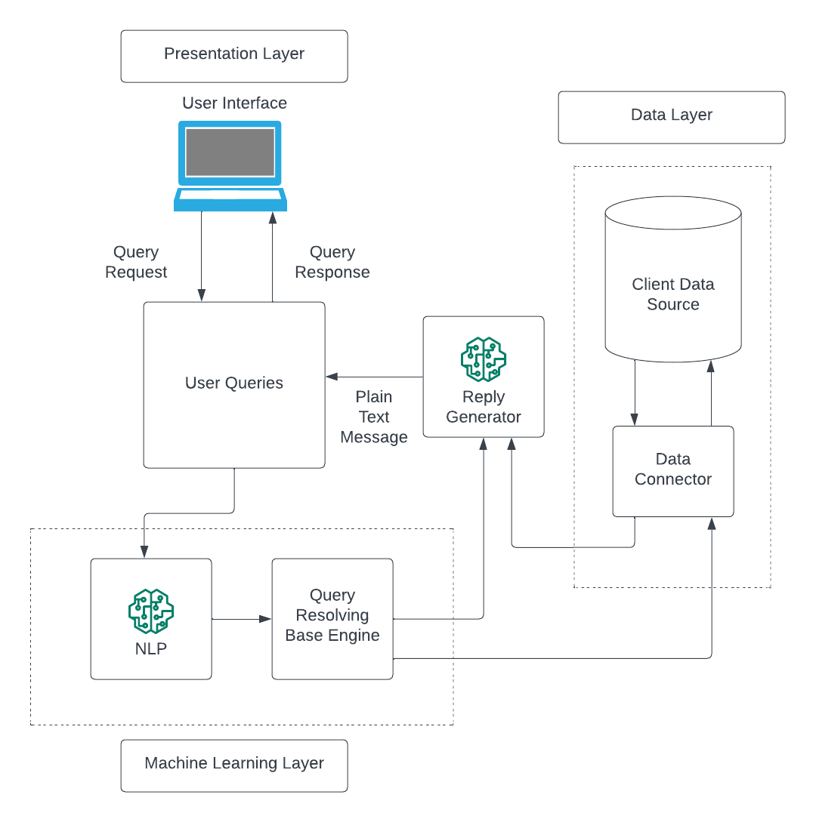
Architecture Diagram

Slide 9
Modules Description
The Healthcare Chatbot project utilizes a combination of programming languages and libraries to achieve its goals:
Python is used as its primary language
Natural Language Processing (NLP) Libraries:
NLTK (Natural Language Toolkit): Used for various NLP tasks like tokenization, stemming, and sentiment analysis.
spaCy- Offers advanced NLP capabilities
Machine Learning and AI Libraries:
Scikit-learn: For data preprocessing.
TensorFlow or PyTorch: For developing and training

Slide 10
Modules Description
4. User Interface Libraries:
HTML, CSS, JavaScript: For building the user interface of the web application.
5. Data Analytics Libraries:
Pandas: For data manipulation and analysis.
NumPy: For numerical computations.
6. Web Frameworks:
Flask: For creating the web application interface and managing user interactions.
7. Cloud Services:
Amazon Web Services (AWS) or Microsoft Azure: For hosting and deploying the chatbot application.

Slide 11
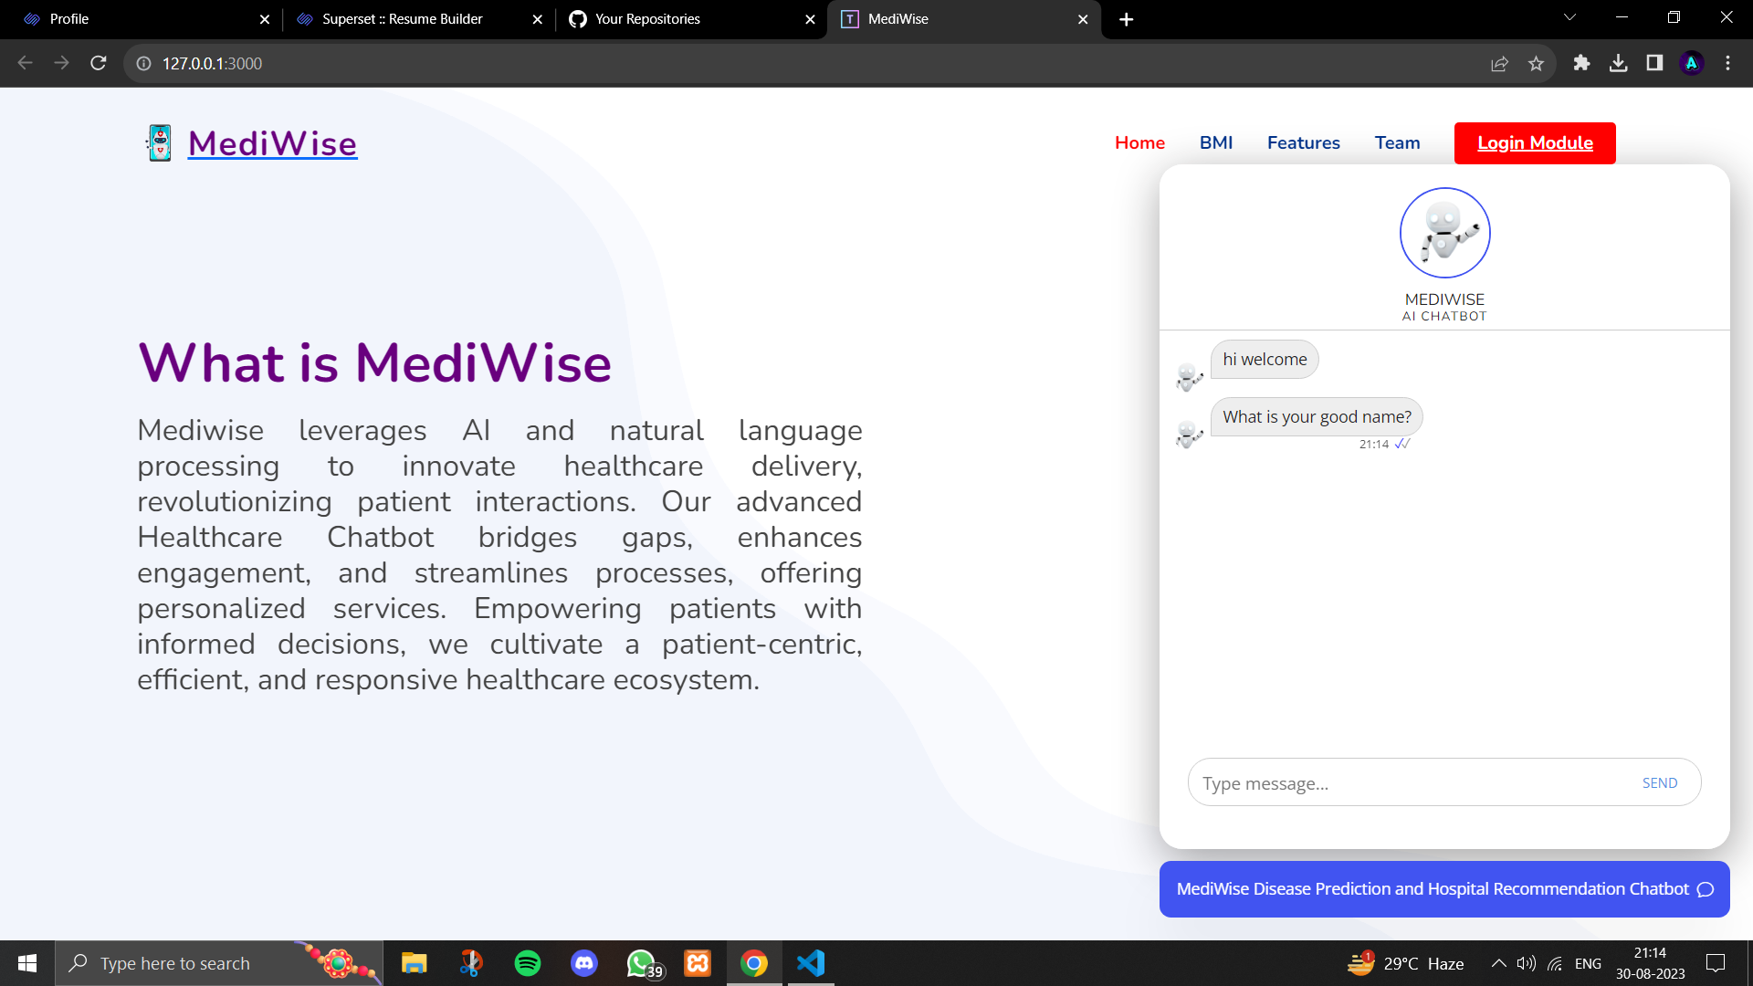
Intermediate Results

Slide 12
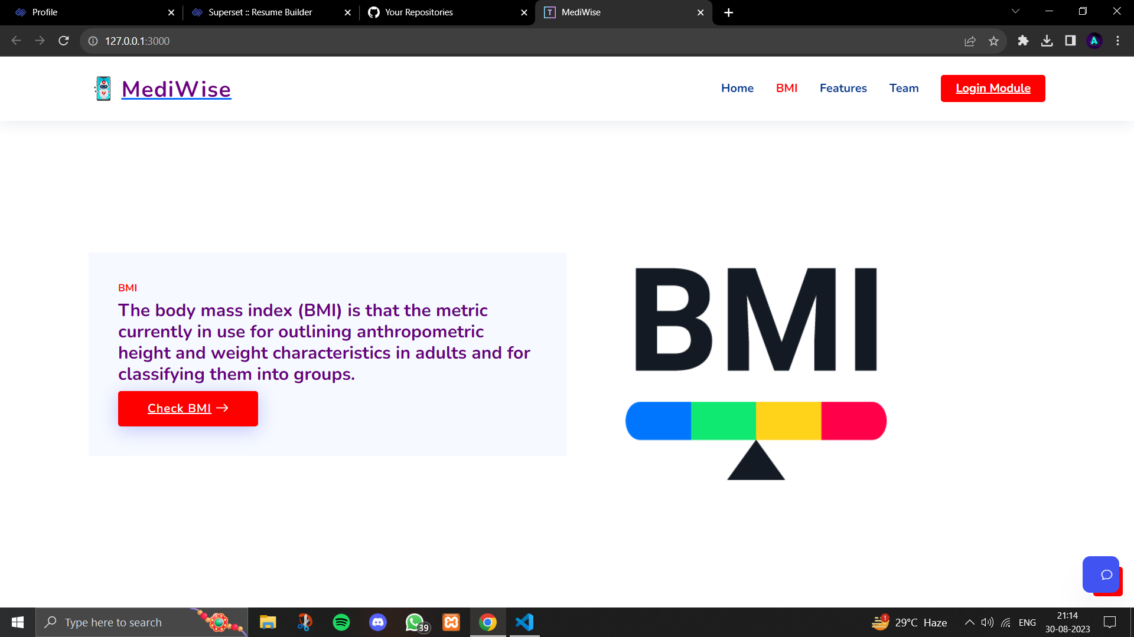
Intermediate Results

Slide 13
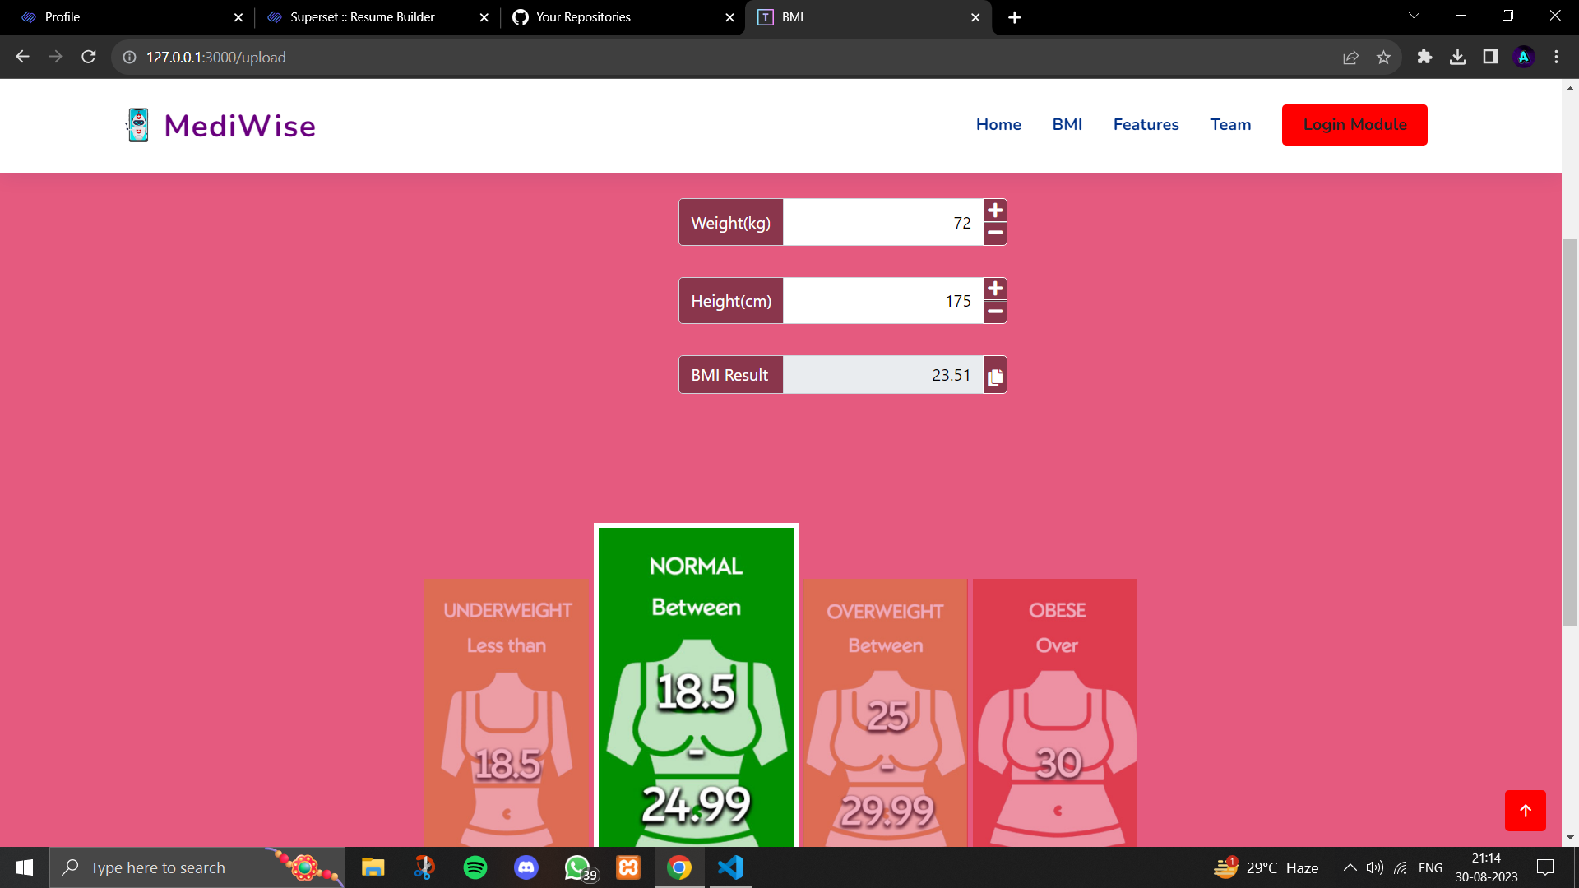
Intermediate Results

Slide 14
References
A Survey on Chatbot Implementation in Health Care using NLTK
The evaluation of chatbot as a tool for health literacy education among undergraduate students
by J. Jinu Sophia, D. Arun Kumar, M. Arutselvan and S. Barath Ram
by Nur Azlina Mohamed Mokmin and Nurul Anwar Ibrahim

Slide 15
Conclusion

Slide 16
Thank You

